Slide 1
Killing The Kill Cord
Reece Williams

Slide 2
The Kill Cord
Device that attaches to both the operator and the controls
In the case of the operator being ejected from boat the operator will no longer be connected to the controls
Should be worn on all boat journeys

Slide 3
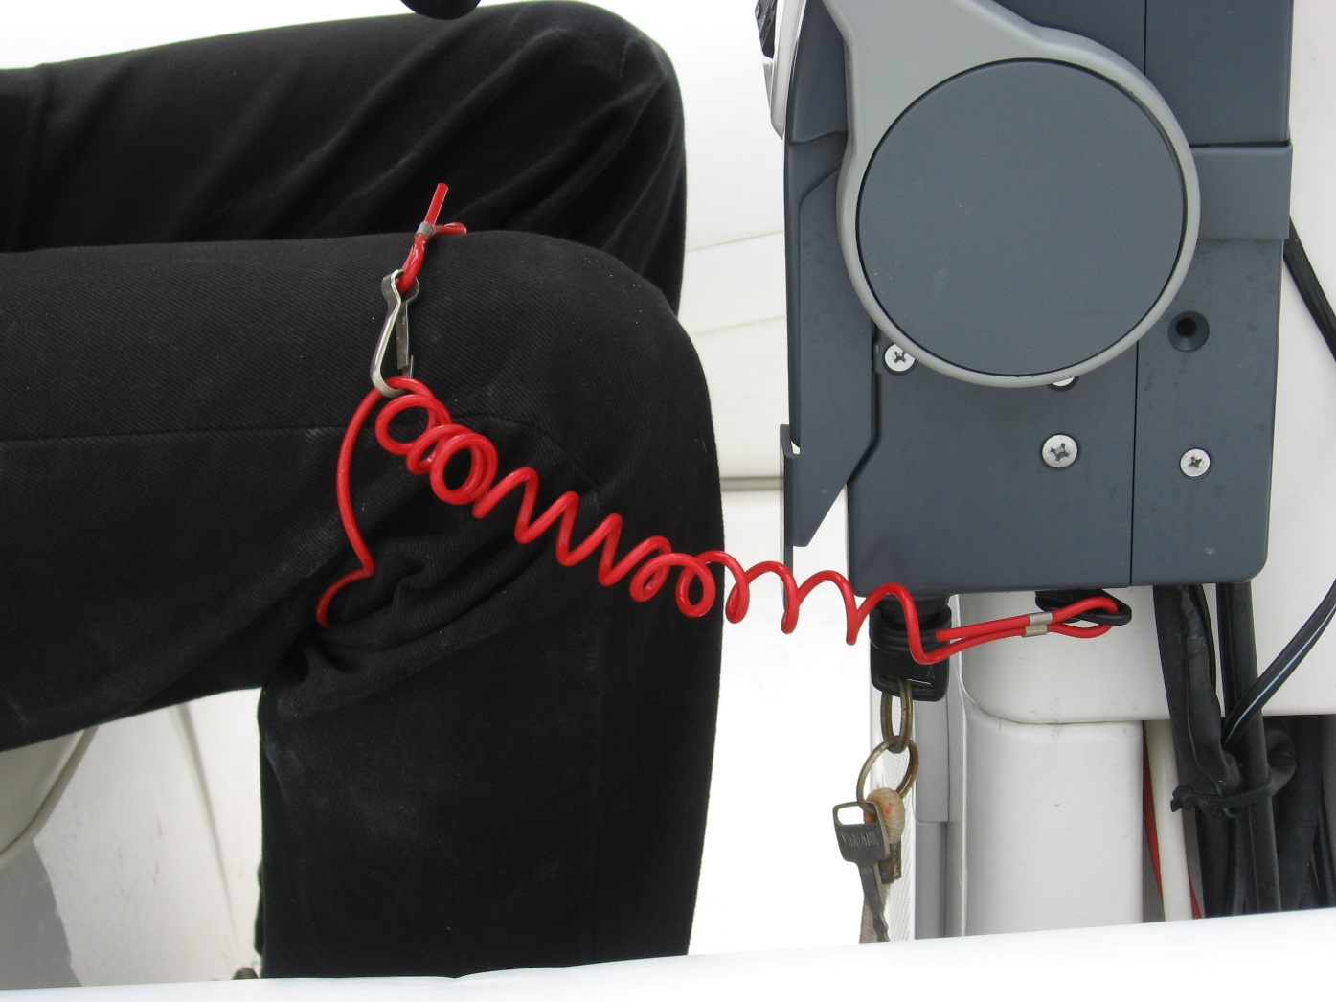
The Kill Cord
Problems:
Operators often forget to wear this cord
It can decay and snap
Switching drivers can be a nuisance
http://www.rya.org.uk/SiteCollectionImages/saftey/Killcordblac-trouser.jpg

Slide 4
Accidents
Padstow Cornwall
Short journey & alcohol leads to operator forgetting to wear kill cord. A sharp turn was made, causing all passengers to be ejected. The boat then circled the passengers as the engine was not cut out leading to a disastrous accident.

Slide 5
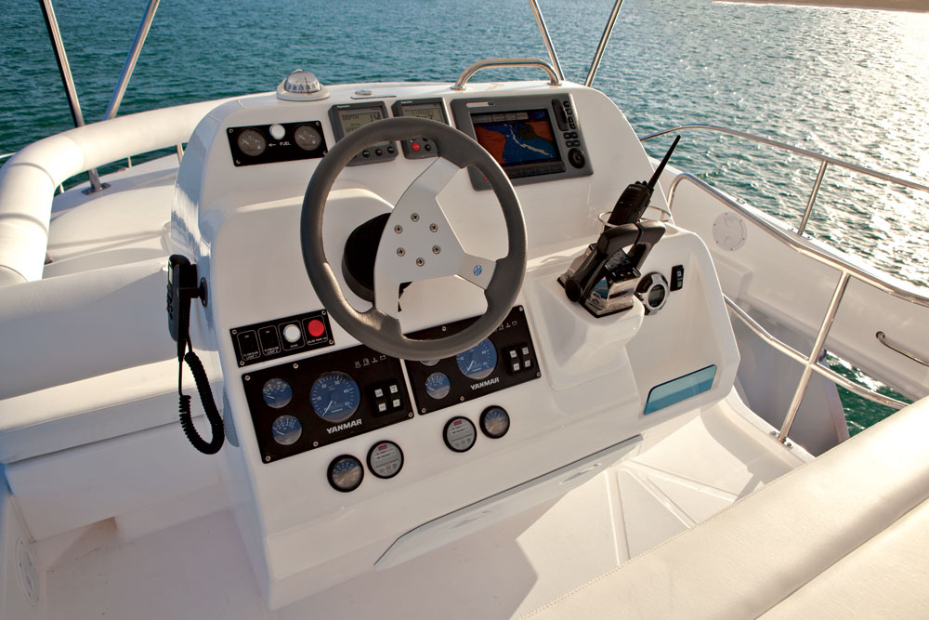
Solution
Sensors in the helm
Touch
Positional
Speed
Proximity
http://www.moorings.co.uk/files/ASSETS/Fleet/Power/393PC_3cab_Cat/Power-Charter-Boat-393pc-Helm.jpg

Slide 6
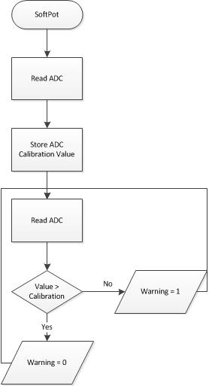
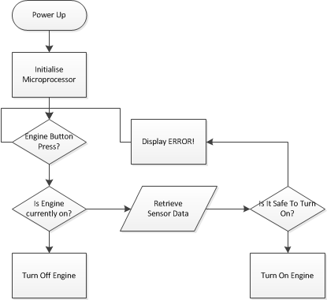

Slide 7
